Slide 1
krypt.semper pi.
krypt. semper pi.
martin boßlet

Slide 2
krypt.semper pi.
whoami
ruby-core
ruby openssl
freelancer

Slide 3

krypt.semper pi.
whoami
germany

Slide 4
krypt.semper pi.
crypto is hard

Slide 5
krypt.semper pi.
u can't touch this

Slide 6

krypt.semper pi.
touched crypto

Slide 7
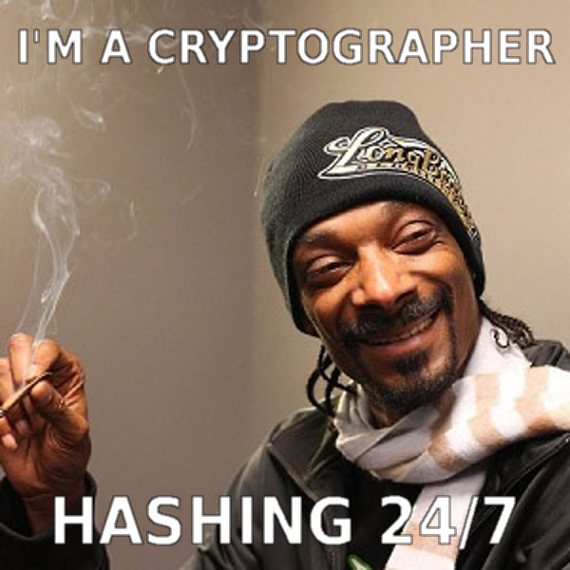
krypt.semper pi.
gets crypto

Slide 8
krypt.semper pi.
so, if crypto is hard

Slide 9
krypt.semper pi.
do crypto apis have to be, too?

Slide 10
krypt.semper pi.
two opposing forces

Slide 11
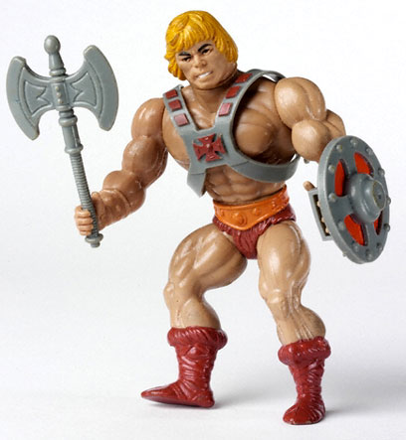
krypt.semper pi.
„when i refactored our login,
i mostly cared about security. what do i care about algorithms? i need my time to work out!“

Slide 12
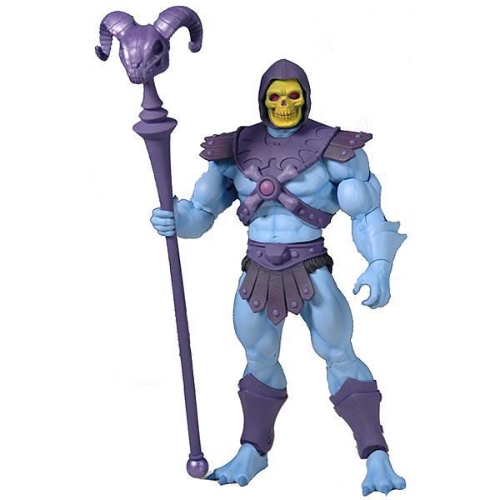
krypt.semper pi.
„i did a lot of ssl pentesting lately.
i need full control of all parameters. and i sure do need my legacy algorithms, dude.“

Slide 13
krypt.semper pi.
everyday development:

Slide 14
krypt.semper pi.
security sucks
security sucks.

Slide 15
krypt.semper pi.
„oh no, not security again!“
security sucks.

Slide 16
krypt.semper pi.
„today was awesome. i got to write crypto code again. boy, did i have fun integrating with our customer's century-old security interface.“
- noone, never

Slide 17

krypt.semper pi.
security is the jar jar binks
of software development

Slide 18
krypt.semper pi.
it's a huge pain
security sucks.

Slide 19
krypt.semper pi.
that must be dealt with
security sucks.

Slide 20
krypt.semper pi.
security can be a real bitch
security sucks.

Slide 21

krypt.semper pi.

Slide 22
krypt.semper pi.
good design
==
making complex things easy
security sucks.

Slide 23
krypt.semper pi.
many examples where this happened
security sucks.

Slide 24
krypt.semper pi.
databases are hard -> active record
security sucks.

Slide 25
krypt.semper pi.
threads are hard -> stm, actors
security sucks.

Slide 26
krypt.semper pi.
memory is hard -> gc
security sucks.

Slide 27
krypt.semper pi.
don't bother me with details
security sucks.

Slide 28
krypt.semper pi.
don't make me think
security sucks.

Slide 29
krypt.semper pi.
crypto is hard -> ???
security sucks.

Slide 30
krypt.semper pi.
but experts™ need full control
security sucks.

Slide 31
krypt.semper pi.
conflict
security sucks.

Slide 32
krypt.semper pi.
abstraction vs. oversimplification
security sucks.

Slide 33
krypt.semper pi.
there is no golden middle
security sucks.

Slide 34
krypt.semper pi.
if full control is your thing:

Slide 35
krypt.semper pi.
openssl
java security api
&
friends

Slide 36
krypt.semper pi.
if all you care about is security by default:

Slide 37
krypt.semper pi.
keyczar (no friends)

Slide 38
krypt.semper pi.
(maybe (rb)nacl / libsodium)

Slide 39
krypt.semper pi.
why not just use keyczar
and be done with it?

Slide 40
krypt.semper pi.
well, there's the experts™

Slide 41

krypt.semper pi.
and legacy apps

Slide 42
krypt.semper pi.
we need both

Slide 43
krypt.semper pi.
full control if needed

Slide 44
krypt.semper pi.
security by default otherwise

Slide 45

krypt.semper pi.
„sadly we can't have both. or can we?“

Slide 46
krypt.semper pi.
revolutionary idea

Slide 47

krypt.semper pi.

Slide 48
krypt.semper pi.
combine both aspects in one library

Slide 49
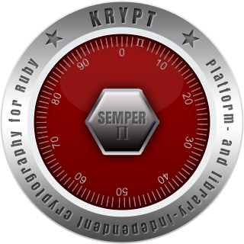
krypt.semper pi.
krypt. semper pi.

Slide 50
krypt.semper pi.
ok, cool, but...

Slide 51

krypt.semper pi.

Slide 52

krypt.semper pi.
who we are
@nahi, @vipulnsward, @abstractj, @qmx, @_emboss_

Slide 53
krypt.semper pi.
will it replace
openssl
java security api
my favorite crypto library
?

Slide 54

krypt.semper pi.
we come in peace

Slide 55
krypt.semper pi.
krypt first of all is a framework
krypt first of all is a framework

Slide 56
krypt.semper pi.
using existing libraries
to implement
core cryptography primitives
krypt first of all is a framework

Slide 57
krypt.semper pi.
peaceful coexistence
(at least at first)
krypt first of all is a framework

Slide 58

krypt.semper pi.
krypt first of all is a framework
expert™
„i see – this is the low-level api that gives me the full control that i so badly need“

Slide 59
krypt.semper pi.
digest
cipher
signature
krypt first of all is a framework

Slide 60
krypt.semper pi.
krypt adds asn.1 dsl to the mix
krypt first of all is a framework

Slide 61
krypt.semper pi.
(asn.1 being crypto's lingua franca)
krypt first of all is a framework

Slide 62
krypt.semper pi.
krypt first of all is a framework
„let's say i write
an app from scratch and all i really care about is the thing being secure – what do i do then?“

Slide 63
krypt.semper pi.
krypt offers high-level api
implemented on this basis
krypt first of all is a framework

Slide 64
krypt.semper pi.
what's the big deal?
krypt first of all is a framework

Slide 65
krypt.semper pi.
crypto code today
krypt first of all is a framework

Slide 66
krypt.semper pi.
#1 encrypting data
krypt first of all is a framework

Slide 67
krypt.semper pi.
what it should look like
krypt first of all is a framework

Slide 68
krypt.semper pi.
krypt first of all is a framework
require 'openssl'
data = 'le secret'
cipher = OpenSSL::Cipher.new('aes-128-cbc')
cipher.encrypt
key = cipher.random_key
iv = cipher.random_iv
enc = cipher.update(data) + cipher.final
decipher = OpenSSL::Cipher::AES.new('aes-128-cbc')
decipher.decrypt
decipher.key = key
decipher.iv = iv
plain = decipher.update(enc) + decipher.final

Slide 69
krypt.semper pi.
what it actually looks like
krypt first of all is a framework

Slide 70
krypt.semper pi.
krypt first of all is a framework
require 'openssl'
data = 'le secret'
key = 'lepasswordlepassword'
cipher = OpenSSL::Cipher.new('AES-128-ECB')
cipher.encrypt
cipher.key = key
enc = cipher.update(data) + cipher.final
decipher = OpenSSL::Cipher::AES.new('AES-128-ECB')
decipher.decrypt
decipher.key = key
plain = decipher.update(enc) + cipher.final

Slide 71
krypt.semper pi.
krypt first of all is a framework
require 'openssl'
data = 'le secret'
key = 'lepasswordlepassword' # fail
cipher = OpenSSL::Cipher.new('AES-128-ECB')
cipher.encrypt
cipher.key = key
enc = cipher.update(data) + cipher.final
decipher = OpenSSL::Cipher::AES.new('AES-128-ECB')
decipher.decrypt
decipher.key = key
plain = decipher.update(enc) + cipher.final

Slide 72
krypt.semper pi.
krypt first of all is a framework
require 'openssl'
data = 'le secret'
key = 'lepasswordlepassword'
cipher = OpenSSL::Cipher.new('AES-128-ECB') # fail
cipher.encrypt
cipher.key = key
enc = cipher.update(data) + cipher.final
decipher = OpenSSL::Cipher::AES.new('AES-128-ECB') # fail
decipher.decrypt
decipher.key = key
plain = decipher.update(enc) + cipher.final

Slide 73
krypt.semper pi.
krypt first of all is a framework
require 'openssl'
data = 'le secret'
key = 'lepasswordlepassword'
cipher = OpenSSL::Cipher.new('AES-128-ECB')
cipher.encrypt
cipher.key = key
# no iv -> fail
enc = cipher.update(data) + cipher.final
decipher = OpenSSL::Cipher::AES.new('AES-128-ECB')
decipher.decrypt
decipher.key = key
# no iv -> fail
plain = decipher.update(enc) + cipher.final

Slide 74
krypt.semper pi.
krypt first of all is a framework
require 'openssl'
data = 'le secret'
key = 'lepasswordlepassword'
cipher = OpenSSL::Cipher.new('AES-128-ECB')
cipher.encrypt # design fail
cipher.key = key
enc = cipher.update(data) + cipher.final
decipher = OpenSSL::Cipher::AES.new('AES-128-ECB')
decipher.decrypt # design fail
decipher.key = key
plain = decipher.update(enc) + cipher.final

Slide 75
krypt.semper pi.
krypt first of all is a framework
require 'openssl'
data = 'le secret'
key = 'lepasswordlepassword'
cipher = OpenSSL::Cipher.new('AES-128-ECB')
cipher.encrypt
cipher.key = key
enc = cipher.update(data) + cipher.final # design fail
decipher = OpenSSL::Cipher::AES.new('AES-128-ECB')
decipher.decrypt
decipher.key = key
plain = decipher.update(enc) + cipher.final # design fail

Slide 76
krypt.semper pi.
#2 pbkdf2 password hash
krypt first of all is a framework

Slide 77
krypt.semper pi.
what it should look like
krypt first of all is a framework

Slide 78
krypt.semper pi.
krypt first of all is a framework
require 'openssl'
pass = 'le secret'
salt = OpenSSL::Random.random_bytes(16)
iter = 20000
len = OpenSSL::Digest::SHA1.new.digest_len # 20
hash = OpenSSL::PKCS5.pbkdf2_hmac_sha1(pass, salt, iter, len)

Slide 79
krypt.semper pi.
what it actually looks like
krypt first of all is a framework

Slide 80
krypt.semper pi.
krypt first of all is a framework
require 'openssl'
pass = 'le secret'
salt = pass
iter = 10
len = password.size
hash = OpenSSL::PKCS5.pbkdf2_hmac_sha1(pass, salt, iter, len)

Slide 81
krypt.semper pi.
krypt first of all is a framework
require 'openssl'
pass = 'le secret'
salt = pass # fail
iter = 10
len = password.size
hash = OpenSSL::PKCS5.pbkdf2_hmac_sha1(pass, salt, iter, len)

Slide 82
krypt.semper pi.
krypt first of all is a framework
require 'openssl'
pass = 'le secret'
salt = pass
iter = 10 # fail
len = password.size
hash = OpenSSL::PKCS5.pbkdf2_hmac_sha1(pass, salt, iter, len)

Slide 83
krypt.semper pi.
krypt first of all is a framework
require 'openssl'
pass = 'le secret'
salt = pass
iter = 10
len = password.size # fail
hash = OpenSSL::PKCS5.pbkdf2_hmac_sha1(pass, salt, iter, len)

Slide 84
krypt.semper pi.
krypt first of all is a framework
require 'openssl'
pass = 'le secret'
salt = pass
iter = 10
len = password.size
# design fail
hash = OpenSSL::PKCS5.pbkdf2_hmac_sha1(pass, salt, iter, len)

Slide 85
krypt.semper pi.
krypt first of all is a framework
require 'openssl'
pass = 'le secret'
salt = pass
iter = 10
len = password.size
o_O
hash = OpenSSL::PKCS5.pbkdf2_hmac_sha1(pass, salt, iter, len)

Slide 86
krypt.semper pi.
what it actually actually looks like
krypt first of all is a framework

Slide 87
krypt.semper pi.
krypt first of all is a framework
require 'openssl'
pass = 'le secret'
salt = pass
digest = OpenSSL::Digest::MD5.new
hash = digest.digest(salt + pass)

Slide 88

krypt.semper pi.

Slide 89
krypt.semper pi.
#3 certificate validation
krypt first of all is a framework

Slide 90
krypt.semper pi.
what it should look like
krypt first of all is a framework

Slide 91
krypt.semper pi.
krypt first of all is a framework
require 'openssl'
store = OpenSSL::X509::Store.new
store.set_default_paths
oh, you know what, i don't
have the time for this...

Slide 92
krypt.semper pi.
almost impossible to do it right™
krypt first of all is a framework

Slide 93
krypt.semper pi.
online revocation checks
krypt first of all is a framework

Slide 94
krypt.semper pi.
openssl refuses to have dependencies
krypt first of all is a framework

Slide 95
krypt.semper pi.
relic of bygone times before
dependency management tools
krypt first of all is a framework

Slide 96
krypt.semper pi.
we're left with half-assed validation
krypt first of all is a framework

Slide 97
krypt.semper pi.
krypto code tomorrow
krypt first of all is a framework

Slide 98
krypt.semper pi.
what it should actually look like
krypt first of all is a framework

Slide 99
krypt.semper pi.
#1 encrypting data
krypt first of all is a framework

Slide 100
krypt.semper pi.
krypt first of all is a framework
require 'krypt'
data = 'le secret'
encrypter = Krypt::Encrypter.new
key = encrypter.generate_key
enc = encrypter.encrypt(data)
decrypter = Krypt::Decrypter.new
decrypter.key = key
plain = decrypter.decrypt(data)

Slide 101
krypt.semper pi.
#2 password hash
krypt first of all is a framework

Slide 102
krypt.semper pi.
krypt first of all is a framework
require 'krypt'
pass = 'le secret'
hash = Krypt::PasswordHash.hash(pass)
begin
Krypt::PasswordHash.verify(hash, pass)
rescue Krypt::PasswordHash::InvalidPassword
# react
end
#swell

Slide 103
krypt.semper pi.
#3 certificate validation
krypt first of all is a framework

Slide 104
krypt.semper pi.
krypt first of all is a framework
require 'krypt'
certificate = Krypt::X509::Certificate.new(bytes)
begin
certificate.verify
rescue Krypt::X509::VerificationError
# react
end
#swell

Slide 105
krypt.semper pi.
don't bother me with details
security sucks.

Slide 106
krypt.semper pi.
don't make me think
security sucks.

Slide 107
krypt.semper pi.
security by default
security sucks.

Slide 108
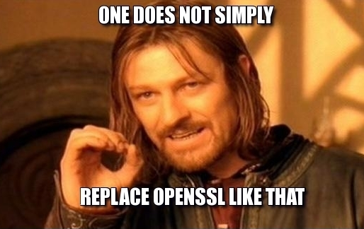
krypt.semper pi.
security sucks.

Slide 109

krypt.semper pi.
yes we can

Slide 110
krypt.semper pi.
use protocols
security sucks.

Slide 111
krypt.semper pi.
moar advantages:
security sucks.

Slide 112
krypt.semper pi.
moar tests
security sucks.

Slide 113
krypt.semper pi.
rspec
FuzzBert
security sucks.

Slide 114
krypt.semper pi.
moar docs (non-expert™)
security sucks.

Slide 115
krypt.semper pi.
moar ruby
security sucks.

Slide 116
krypt.semper pi.
easier to understand & maintain
security sucks.

Slide 117
krypt.semper pi.
minimal portion of native code
krypt first of all is a framework

Slide 118
krypt.semper pi.
using whatever library is available
in the background
krypt first of all is a framework

Slide 119
krypt.semper pi.
diversity
security sucks.

Slide 120
krypt.semper pi.
the rest is plain ruby
krypt first of all is a framework

Slide 121
krypt.semper pi.
„why should anyone care?“
krypt first of all is a framework

Slide 122
krypt.semper pi.
write once, run anywhere™
krypt first of all is a framework
2

Slide 123
krypt.semper pi.
run on all rubies
security sucks.

Slide 124
krypt.semper pi.
„what do i care
if your stupid crypto library works?“
krypt first of all is a framework

Slide 125
krypt.semper pi.
https
krypt first of all is a framework

Slide 126
krypt.semper pi.
if https doesn't work,
ruby doesn't work
krypt first of all is a framework

Slide 127
krypt.semper pi.
(https://rubygems.org, anyone?)
krypt first of all is a framework

Slide 128
krypt.semper pi.
openssl isn't available everywhere
krypt first of all is a framework

Slide 129
krypt.semper pi.
yet another
c (or java) extension is not the answer
krypt first of all is a framework

Slide 130
krypt.semper pi.
only ruby runs on every ruby
krypt first of all is a framework

Slide 131
krypt.semper pi.
this is part of java's success
krypt first of all is a framework

Slide 132
krypt.semper pi.
provider (native code)
krypt (ruby code)
krypt first of all is a framework
ffi (all rubies)
java (jruby only)

Slide 133


krypt.semper pi.
„what's yours is mine!“

Slide 134
krypt.semper pi.
use openssl on jruby
krypt first of all is a framework

Slide 135
krypt.semper pi.
benefit from fips validation
krypt first of all is a framework

Slide 136
krypt.semper pi.
w/o changing any of the code
krypt first of all is a framework

Slide 137


krypt.semper pi.
le demo
krypt first of all is a framework

Slide 138
krypt.semper pi.
same code runs on all platforms
krypt first of all is a framework

Slide 139
krypt.semper pi.
using different parts to get there
krypt first of all is a framework

Slide 140
krypt.semper pi.
write once, run anywhere™
krypt first of all is a framework
2

Slide 141
krypt.semper pi.
future: all-ruby provider
krypt first of all is a framework

Slide 142
krypt.semper pi.
„if it runs ruby, it runs krypt“
krypt first of all is a framework

Slide 143
krypt.semper pi.
think:
webrick
vs.
thin, unicorn, puma, torquebox, ...
krypt first of all is a framework

Slide 144
krypt.semper pi.
off-topic: other programming langs
krypt first of all is a framework

Slide 145
krypt.semper pi.
c-based: tightly coupled to openssl
krypt first of all is a framework

Slide 146
krypt.semper pi.
write once, run anywhere™
krypt first of all is a framework
2
aka: „write many times, run nowhere“

Slide 147
krypt.semper pi.
java-based:
tightly coupled to java security api
or bouncy castle
krypt first of all is a framework

Slide 148
krypt.semper pi.
write once, run anywhere™
krypt first of all is a framework
2

Slide 149
krypt.semper pi.
but:
no c libraries
expert™ api only
krypt first of all is a framework

Slide 150
krypt.semper pi.
why not give those guys a break, too?
krypt first of all is a framework

Slide 151
krypt.semper pi.
make krypt a full-blown c & java lib
krypt first of all is a framework

Slide 152
krypt.semper pi.
blueprint for jvm- and c-based languages
krypt first of all is a framework

Slide 153
krypt.semper pi.
write once, run anywhere™
krypt first of all is a framework
2

Slide 154

krypt.semper pi.
krypt all the things

Slide 155
krypt.semper pi.
once we take over the world
krypt first of all is a framework

Slide 156
krypt.semper pi.
we make sure to be gentle
to the people in this room
krypt first of all is a framework

Slide 157
krypt.semper pi.
if nobody picks up the idea?
krypt first of all is a framework

Slide 158
krypt.semper pi.

Slide 159

krypt.semper pi.
„at least we'll have
flawless design“

Slide 160
krypt.semper pi.
is it any good?
krypt first of all is a framework

Slide 161
krypt.semper pi.
participating in jruby gsoc '12 & '13
krypt first of all is a framework

Slide 162
krypt.semper pi.
two projects featuring devwrat & matthew
krypt first of all is a framework

Slide 163
krypt.semper pi.
https://github.com/jruby/jruby/commit/cc9acbaf2
„Incorporate Krypt and wire it up for OpenSSL::PKCS5.“
krypt first of all is a framework

Slide 164

krypt.semper pi.
krypt first of all is a framework

Slide 165

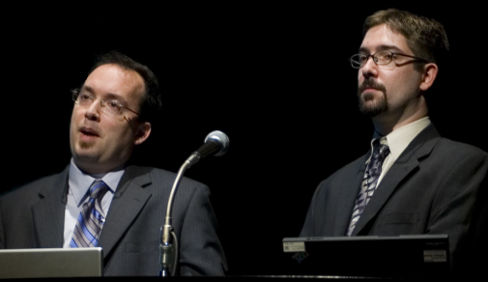
krypt.semper pi.
„thank you!!!“

Slide 166
krypt.semper pi.
still a long road ahead of us
krypt first of all is a framework

Slide 167
krypt.semper pi.
plan: krypt as default crypto library
plan: krypt as default crypto library
krypt first of all is a framework

Slide 168
krypt.semper pi.
sneaky plan:
use openssl shim for the interim period
krypt first of all is a framework

Slide 169
krypt.semper pi.
https://github.com/krypt/krypt-ossl
krypt first of all is a framework

Slide 170
krypt.semper pi.
thank you
https://github.com/krypt
http://martinbosslet.de
martin.bosslet@gmail.com
@_emboss_
krypt first of all is a framework

